Slide 1

Module 5: AI in Cyber Security
Dilip Kumar

Slide 2
Learning
“Learning is any process by which a system improves performance from experience.”
- Herbert Simon
Learning or Human learning is all about observing things, recognizing a pattern, elaborating a theory or model which explains that pattern, and then putting that theory to the test and checking whether it matches most or all of the observations.
Learning is, basically, a model that represents a pattern within a collection of observations.

Slide 3
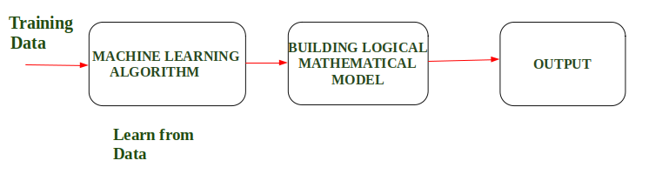
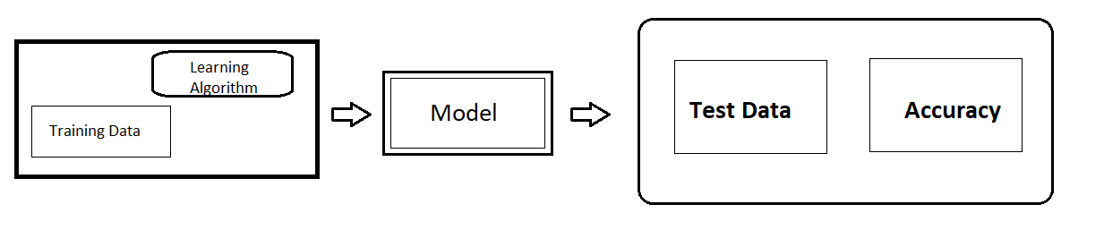
Designing the learning System
Machine Learning enables a Machine to Automatically learn from Data, improve performance from an Experience and predict things without explicitly programmed.
4

Slide 4
Designing the learning System
1. Choosing the Training Experience
2. Choosing the Target Function
3. Choosing a Representation for the Target Function
4. Choosing a Function Approximation Algorithm
5. The Final Design
4

Slide 5
Well defined learning problems
Web search
E-commerce
Robotics
Information extraction
Social networks
Computational biology
Finance
Space exploration
Debugging software
4

Slide 6
Life-cycle of ML (Process)
Define project objective
Data Collection
Data Preprocessing
Data Visualization
Model Selection
Model Building
Deployment
4

Slide 7
What is Machine Leaning (Cont…)
Traditional Programming
Data(Input) Program
Traditional
Programming
Output
Machine Learning
Data (Input) Output
Machine
Learning
Program
4

Slide 8

Introduction of Machine Leaning
Product Rate
2010 | 2130
10 | 35
20 | 65
30 | 95
40
50 | 155
60 | 185
70 | 215
80 | 245
90 | 275
100 | 305

Slide 9
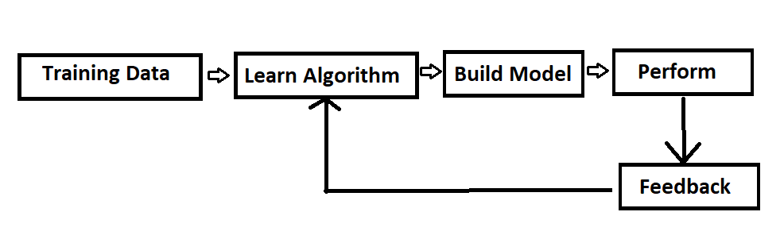
Introduction of Machine Leaning
Machine Learning is the field of study that gives computers the capability to learn without being explicitly program.
Machine Learning is a concept which allows the machine to learn from examples and experience
The primary aim is to allow the computers to learn automatically.

Slide 10
Introduction of Machine Leaning
According to Tom Mitchell, “A computer program is said to be learning from experience (E), with respect to some task (T). Thus, the performance measure (P) is the performance at task T, which is measured by P, and it improves with experience E.”
In Short, by Tom Mitchell (1998):
Machine Learning is the study of algorithms that
improve their performance P
at some task T
with experience E.
A well-defined learning task is given by <P, T, E>.

Slide 11
Introduction of Machine Leaning
Example: In Spam E-Mail detection,
Task, T: To classify mails into Spam or Not Spam.
Performance measure, P: Total percent of mails being correctly classified as being “Spam” or “Not Spam”.
Experience E: Set of Mails with label “Spam”

Slide 12
Introduction of Machine Leaning
Machine Learning is a subset of artificial intelligence which focuses mainly on machine learning from their experience and making predictions based on its experience.
It allows software application to learn from the data & become more accurate in predicting outcomes without human intervention.

Slide 13
Introduction of Machine Leaning
ML is a type of AI that provides computers with the ability to learn without being explicitly programmed.
Artificial Intelligence
Machine learning
4

Slide 14
Step to implement ML Algo.
Step1: Collecting Data(Load)
Step2: Cleaning data (Useful Field) [Prepare]
Step3: Analyze Data[Manipulate]
Step4: Train the algorithm
Step5: Test the algorithm
Step6: Use it.

Slide 15
Terms frequently used
Labelled data: Data consisting of a set of training examples, where each example is a pair consisting of an input and a desired output value (also called the supervisory signal, labels, etc.)
Classification: The goal is to predict discrete values, e.g. {1,0}, {True, False}, {spam, not spam}.
Regression: The goal is to predict continuous values, e.g. home prices.

Slide 16
Types of Machine Learning
Machine learning
Supervised learning
Unsupervised learning
Semi-Supervised learning
Reinforcement learning
4

Slide 17
Types of Machine Learning
Supervised (inductive) learning
  Given: training data + desired outputs (labels)
Unsupervised learning
  Given: training data (without desired outputs)
Semi-supervised learning
  Given: training data + a few desired outputs
Reinforcement learning
  Rewards from sequence of actions
4

Slide 18
Supervised Machine Learning
Supervised Learning is the one, where you can consider the learning is guided by a teacher.
We have a dataset which acts as a teacher and its role is to train the model or the machine.
Once the model gets trained it can start making a prediction or decision when new data is given to it.
It’s also Known as predictive modelling
Supervised learning is the process of an algorithm, learning from training data set.
Interfering a function from labelled training data.
  Diagram in fig1
  Ex: X-> Mapping Function -> Y
  Example: Linear regression, logistic regression, decision tree, random forest, naive bayes.
4

Slide 19
Supervised Machine Learning
Conclusion:
Predictive Model
we have labelled data
The main types of supervised learning problems include regression and classification problems.
4

Slide 20
Supervised Machine Learning
List of Common Algorithms
  Nearest Neighbour
  Naive Bayes
  Decision Trees
  Linear Regression
  Support Vector Machines (SVM)
  Neural Networks
4

Slide 21
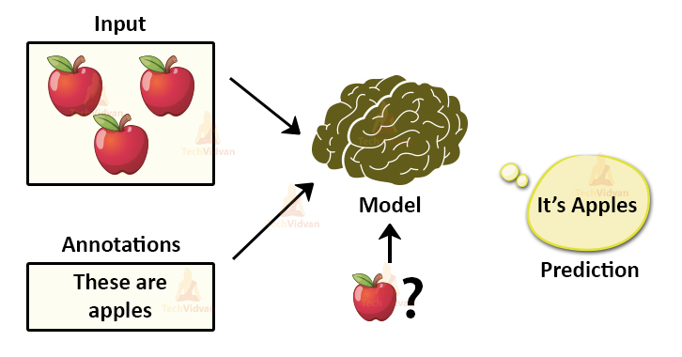
Supervised Machine Learning
4

Slide 22
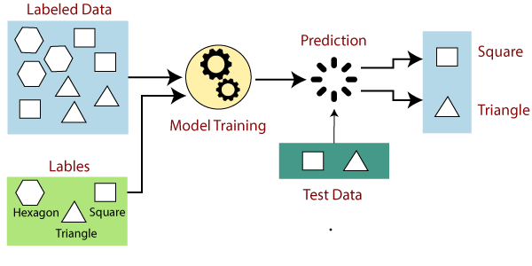
Supervised Machine Learning
4

Slide 23
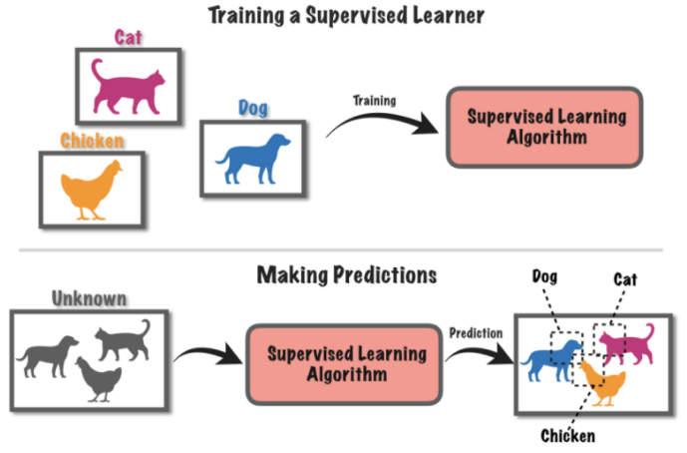
Supervised Machine Learning
4

Slide 24
Disadvantage of Supervised machine
The most basic disadvantage of any Supervised Learning algorithm is that the dataset has to be hand-labeled either by a Machine Learning Engineer or a Data Scientist.
This is a very costly process, especially when dealing with large volumes of data.
4

Slide 25
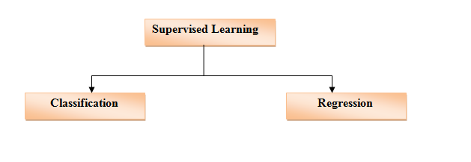
Supervised Machine Learning
4

Slide 26
Unsupervised Machine Learning
Unsupervised Learning is a machine learning technique in which the users do not need to supervise the model.
It creates a model that tries to understand hidden pattern within the unlabeled data.
It mainly deals with the unlabeled data.
Given: training data (without desired outputs)
This is a process where a model is trained using an information which is not labelled.
Here process can be used to cluster the input data in classes on the basis of some statistical properties, also called clustering analysis.
4

Slide 27
Unsupervised Machine Learning
Conclusion:
Descriptive Model
The main types of unsupervised learning algorithms include Clustering algorithms and Association rule learning algorithms.
4

Slide 28
Unsupervised Machine Learning
List of Common Algorithms
k-means clustering, Association Rules
4

Slide 29
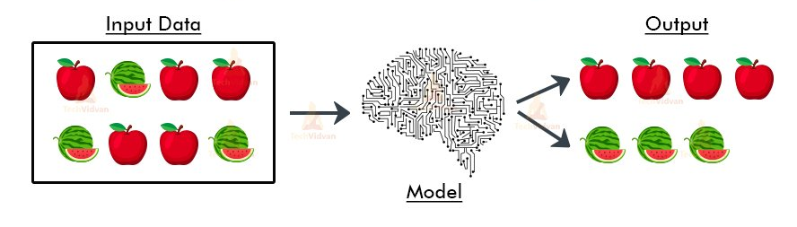
Unsupervised Machine Learning
4

Slide 30
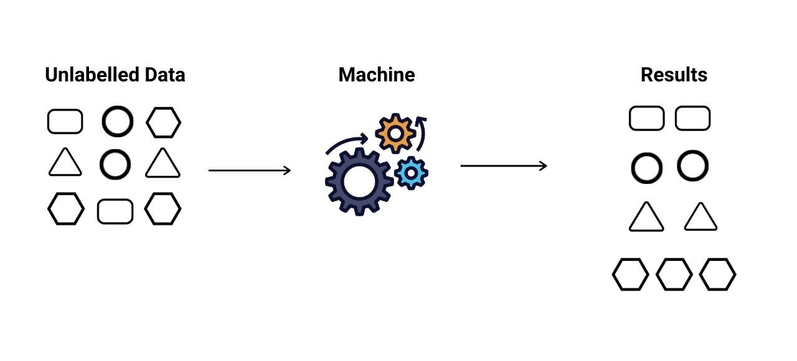
Unsupervised Machine Learning
4

Slide 31
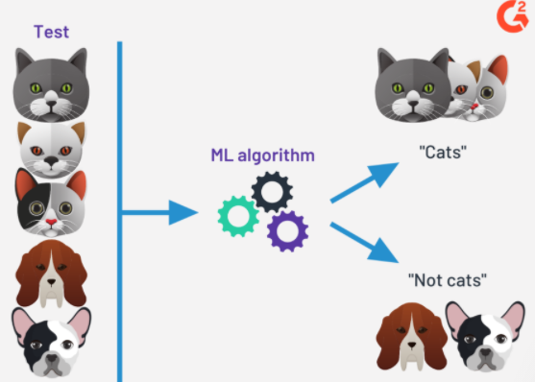
Unsupervised Machine Learning
4

Slide 32
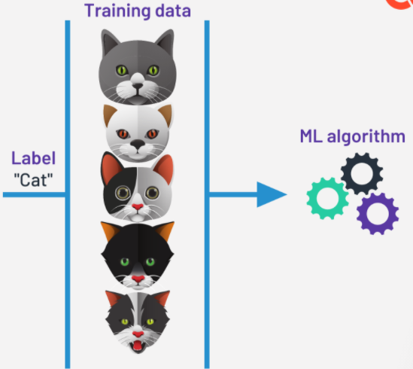
Unsupervised Machine Learning
4

Slide 33
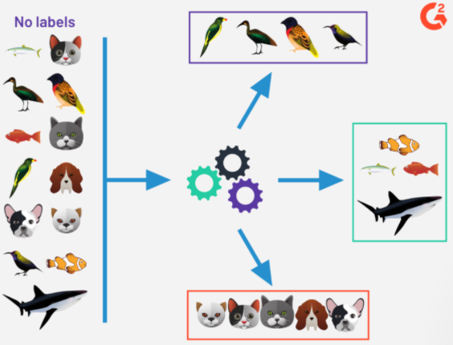
Unsupervised Machine Learning
4

Slide 34
Disadvantage of Unsupervised ML
The most basic disadvantage of any Unsupervised Learning is that it’s application spectrum is limited.
4

Slide 35
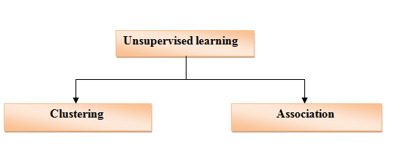
Unsupervised Machine Learning
4

Slide 36
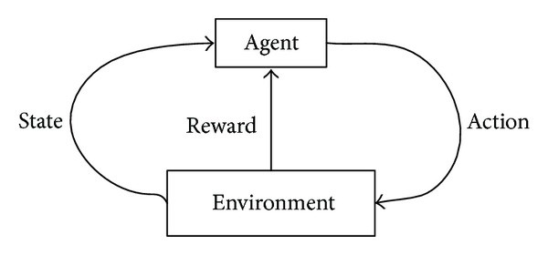
Reinforcement Machine Learning
This learning is learning by interacting with a space or an environment.
Reinforcement Learning is a feedback-based Machine learning technique in which the agent learns automatically using feedbacks without any labeled data, unlike supervised learning.
There is no labeled data, so the agent is bound to learn by its experience only.
It follows the concept of hit and trial method.
4

Slide 37
Reinforcement Machine Learning
List of Common Algorithms
  Q-Learning
  Temporal Difference (TD)
  Deep Adversarial Networks
4

Slide 38
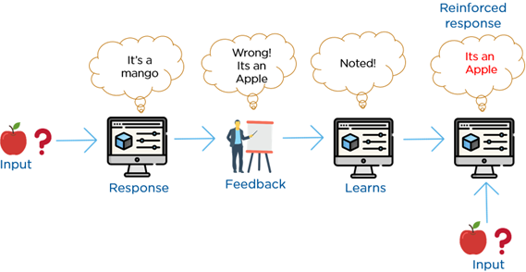
Reinforcement Machine Learning
4

Slide 39
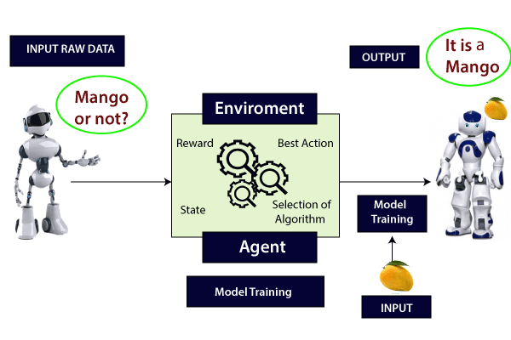
Reinforcement Machine Learning
4

Slide 40
Semi-Supervised machine learning
Semi-Supervised Learning is combination of labeled and unlabeled data.
This combination will contain a very small amount of labeled data and a very large amount of unlabeled data.
Semi-supervised learning falls between unsupervised learning and supervised learning.
4

Slide 41
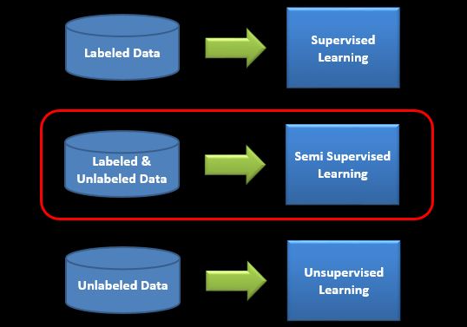
Semi-Supervised machine learning
4

Slide 42
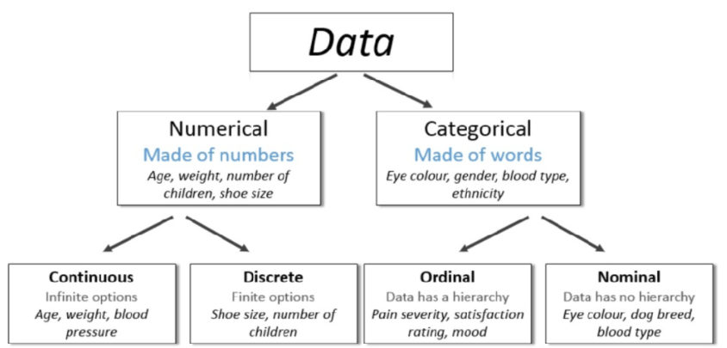
Data Type in ML
4

Slide 43
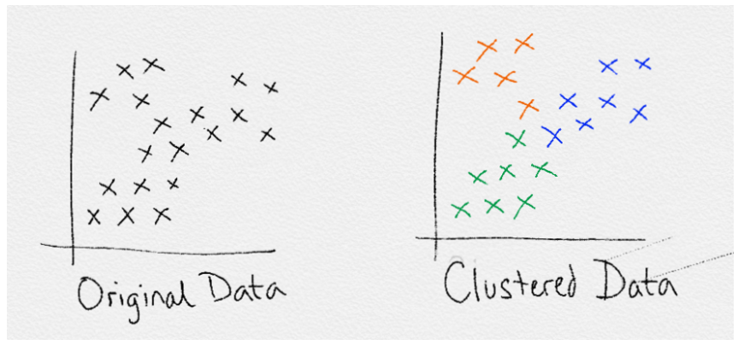
Clustering
Clustering is unsupervised learning algorithm means Used to groups the unlabeled dataset.
It means labels are not present in training data
Clustering is the process defined as “A way of grouping the data points into different groups or clusters, consisting of similar data points” or can say Clustering is a division of data into groups of similar object.
It is basically a collection of objects on the basis of similarity and dissimilarity between them.
Example: K-Mean clustering
4

Slide 44
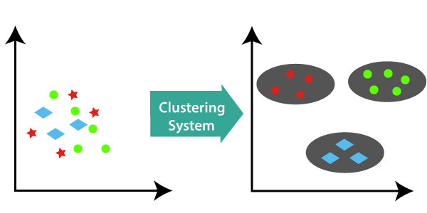
Clustering
The objects with the possible similarities remain in a group that has less or no similarities with another group.
A cluster is a collection of data object that are similar to one another within the same cluster and are dissimilar to the object in the other cluster.
4

Slide 45
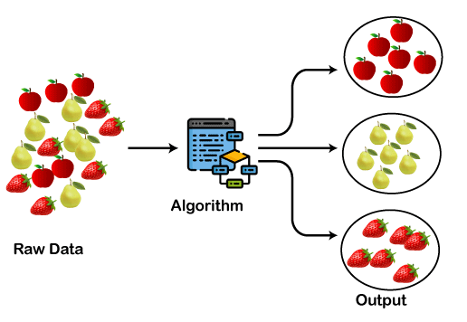
Clustering
Clustering is somewhere similar to the classification algorithm, but the difference is the type of dataset that we are using.
In classification, we work with
the labeled data set, whereas in clustering, we
work with the unlabeled dataset.
4

Slide 46
Clustering (Cont.)
Types of clustering
  Exclusive clustering
  Overlapping Clustering
  Hierarchical clustering
4

Slide 47
Applications of Clustering in different fields
Data reduction
Hypothesis generation
Hypothesis testing
Marketing
Biology
Libraries
Insurance
City Planning:
Earthquake studies: By learning the earthquake-affected areas we can determine the dangerous zones.
4

Slide 48
Classification
The Classification algorithm is a Supervised Learning technique.
Classification is a process of categorizing a given set of data into classes, It can be performed on both structured or unstructured data.
Classification based algorithms are used whenever there is some certain (discrete value) output variable, i.e., either Red or Blue, Yes-No, Male-Female, 0 or 1, etc.
In Classification, a program learns from the given dataset or observations and then classifies new observation into a number of classes or groups. Such as, Yes or No, 0 or 1, Spam or Not Spam, cat or dog, etc.
4

Slide 49
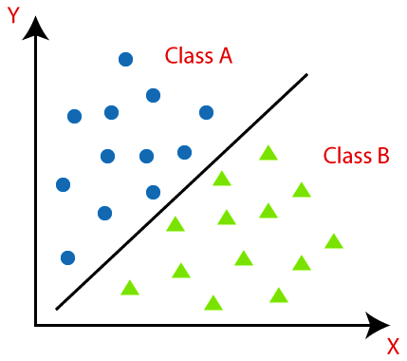
Classification
Used to identify the category of new observations on the basis of training data.
The process starts with predicting the class of given data points. The classes are often referred to as target, label or categories.
The main goal is to identify which class/category the new data will fall into.
4

Slide 50
Types of Classification
Classification Algorithms can be further divided into the Mainly two category:
Linear Models
  Logistic Regression
  Support Vector Machines
Non-linear Models
  K-Nearest Neighbors
  Kernel SVM
  Naïve Bayes
  Decision Tree Classification
  Random Forest Classification
4

Slide 51
Application of Classification Algorithms
Email Spam Detection
Speech Recognition
Identifications of Cancer tumor cells.
Drugs Classification
Biometric Identification, etc.
4

Slide 52
Clustering Vs. Classification
Clustering
Classification
It is considered as unsupervised learning
No prior knowledge of the class labels or attribute of the data to form clusters.
It is done by grouping only the input data because output is not predefined
It is considered as supervised learning
There is some prior knowledge of the attribute of each classification, means Class labels are known
It is done by classifying output based on the values of the input data.
4

Slide 53

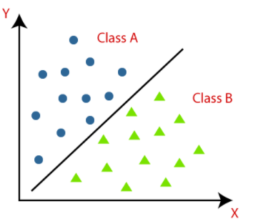
Clustering Vs. Classification
Clustering
Classification
The number of cluster is not known before clustering. These are identified after the completion of clustering
Class label is not known
The number of classes is known before classification as there is predefined output based on input data.
Class label is known
4

Slide 54
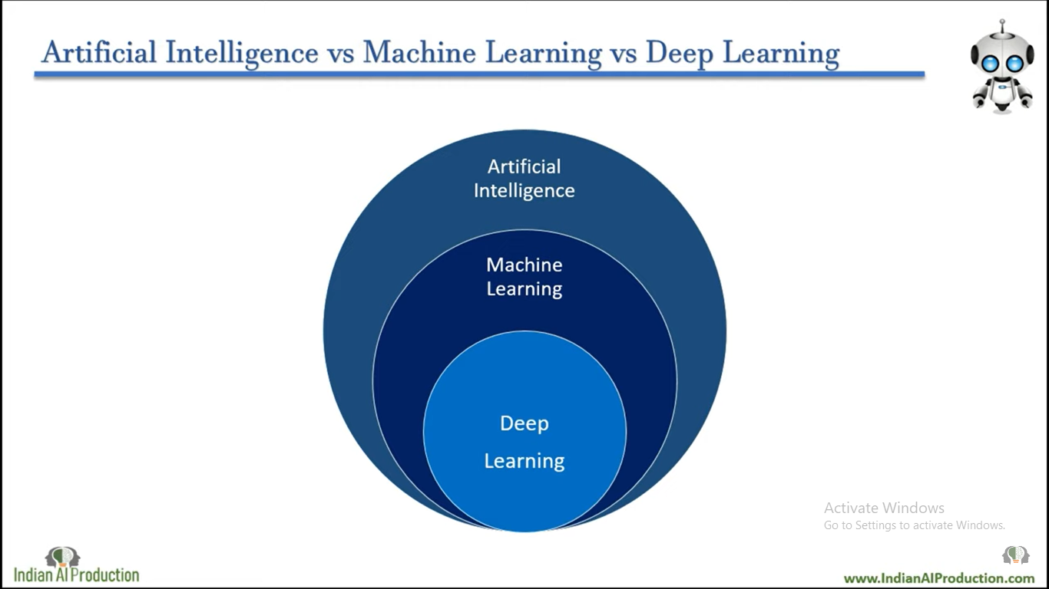
AI, ML and deep learning
Data science
Figure – 2 Relationship –AI ,ML and deep learning
4

Slide 55
Thankyou

